Slide 1
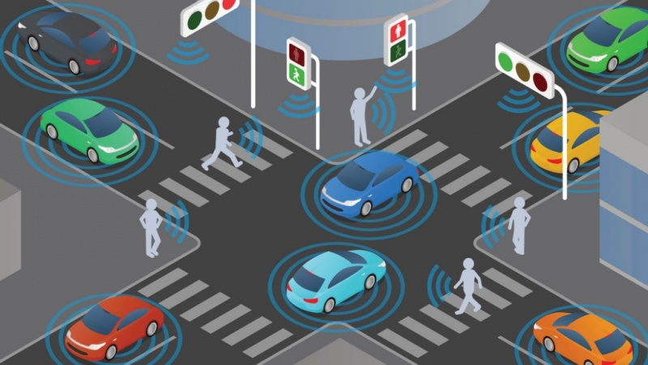
Smart City System
Requirements
Analysis
Design
Implementation & Test

Slide 2
Requirements Diagram
Requirements

Slide 3
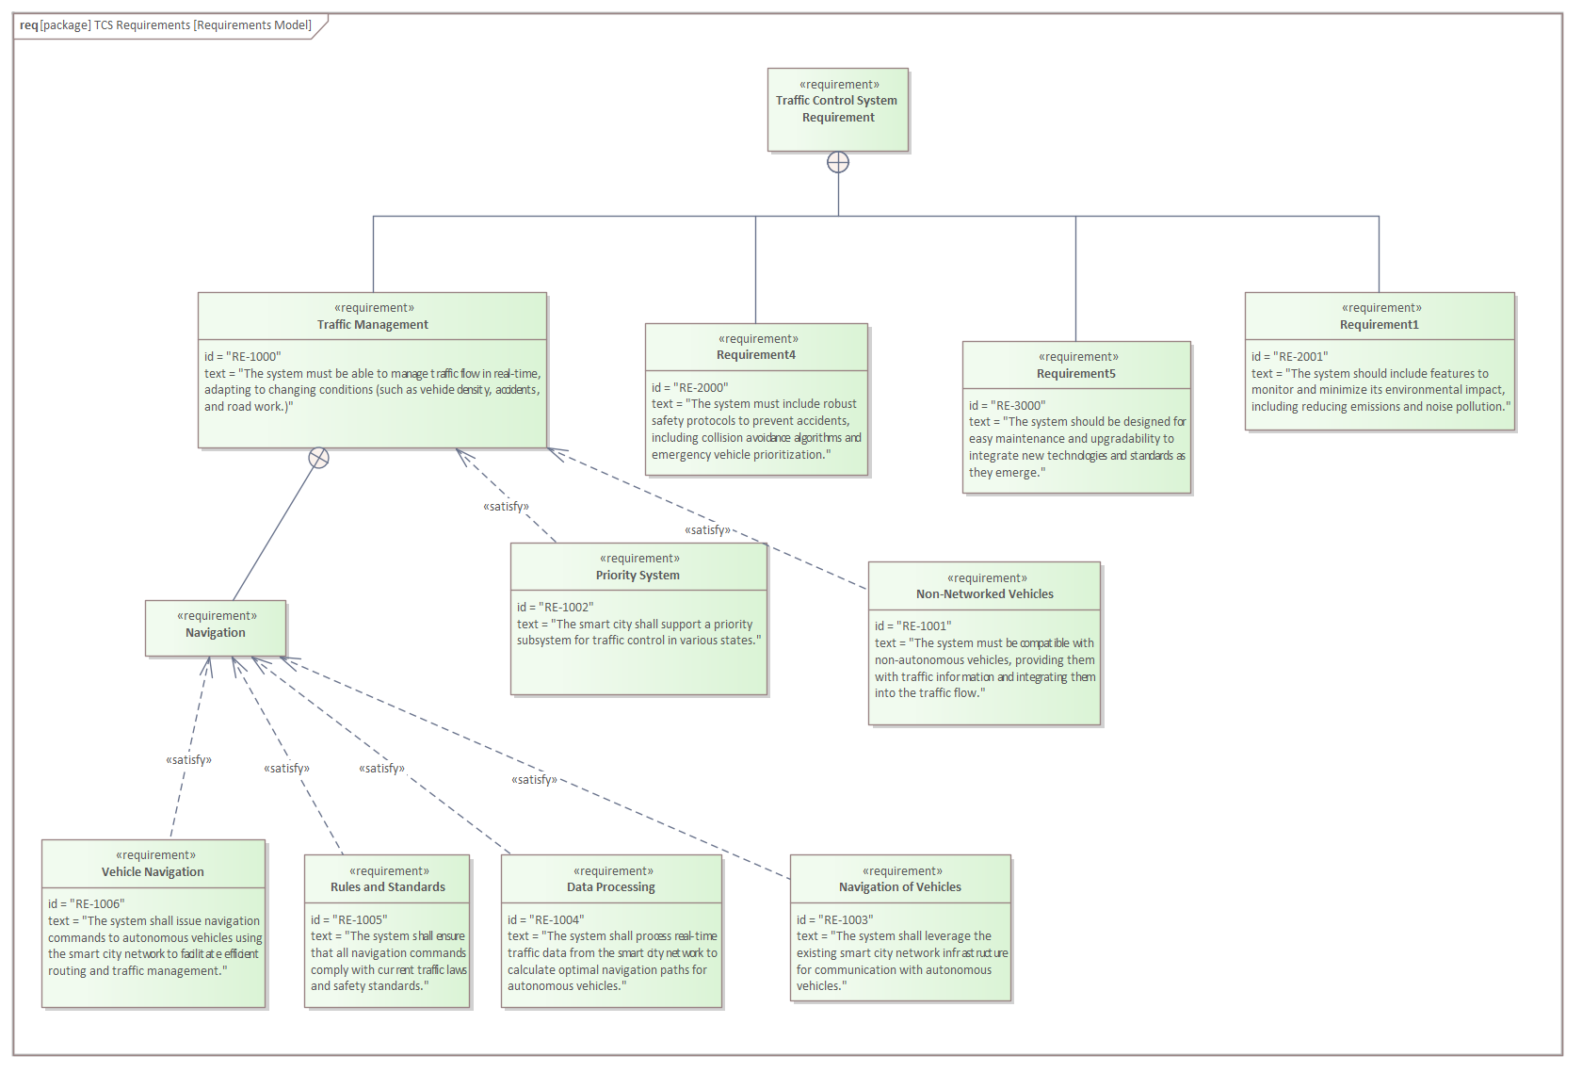
Purpose: - graphical representation - ”what” to achieve - locating errors in early stages Properties: - unique identifier - textual description Relations: - Containment - Refinement - Derivation - refine (behavioural element) - satisfy (architecture block) - verify (test case)

Slide 4
Use Case Diagram
Analysis

Slide 5
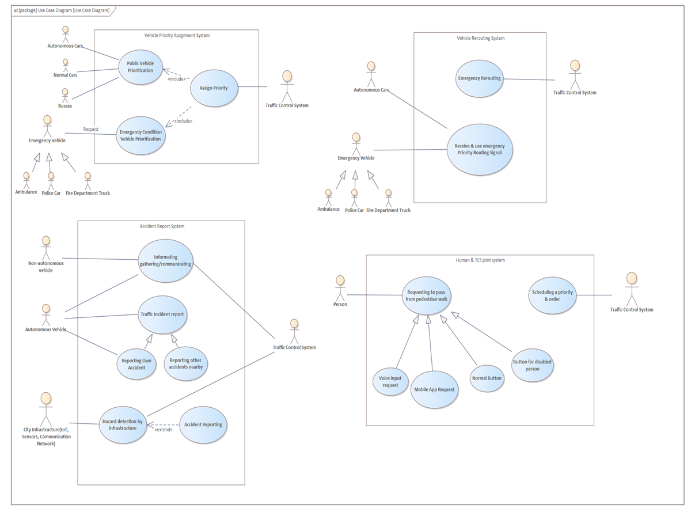
Purpose: - Specify system context - Capture system requirements - Validate system architecture - Drive implementation & generate test cases Consists of: - Actors - Use cases - Communication links - System boundaries

Slide 6
Sequence Diagram

Slide 7
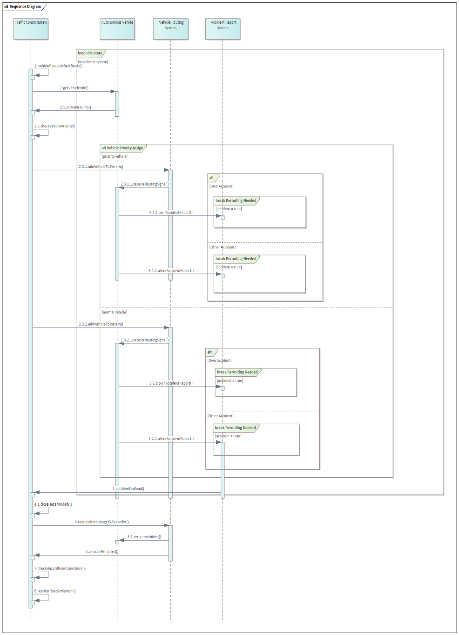
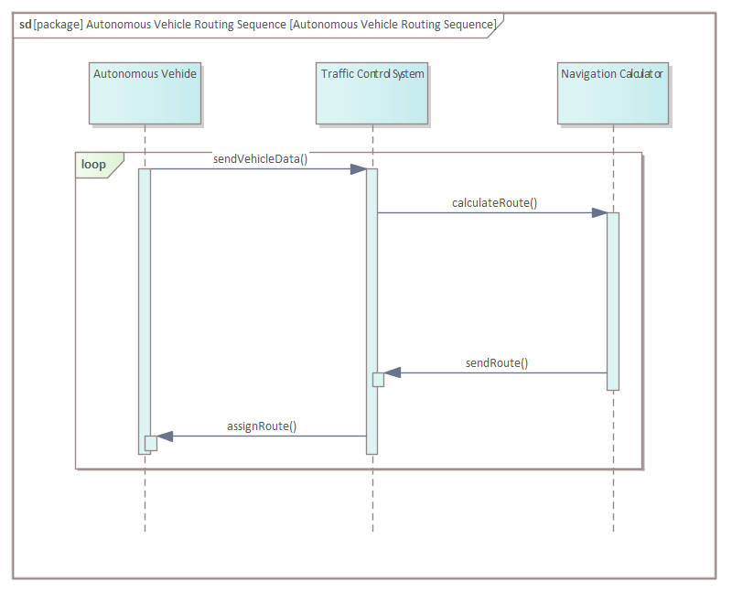
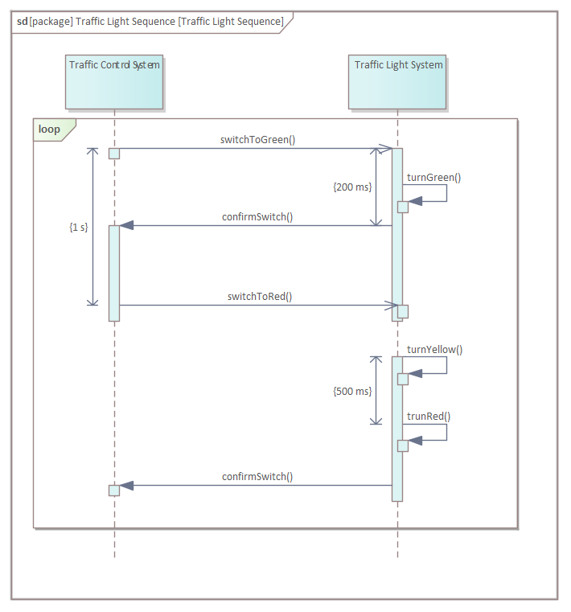
Purpose: - Operation’s order of execution Consists of: - Objects - Time Notation: - Actors - Life Line - Message - Note/Comment - Sequence Fragments

Slide 8
Activity Diagrams

Slide 9
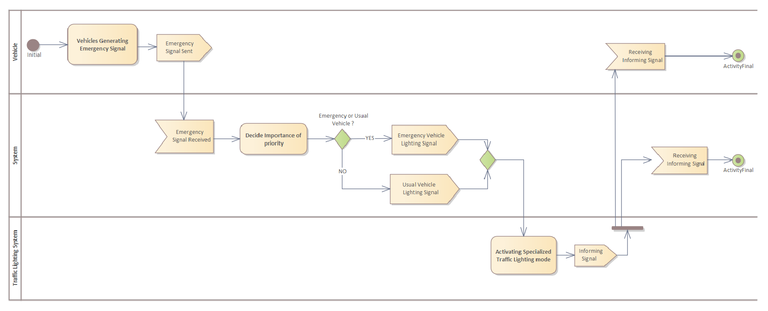
Figure: Traffic Lighting Priority System (Activity Diagram)

Slide 10
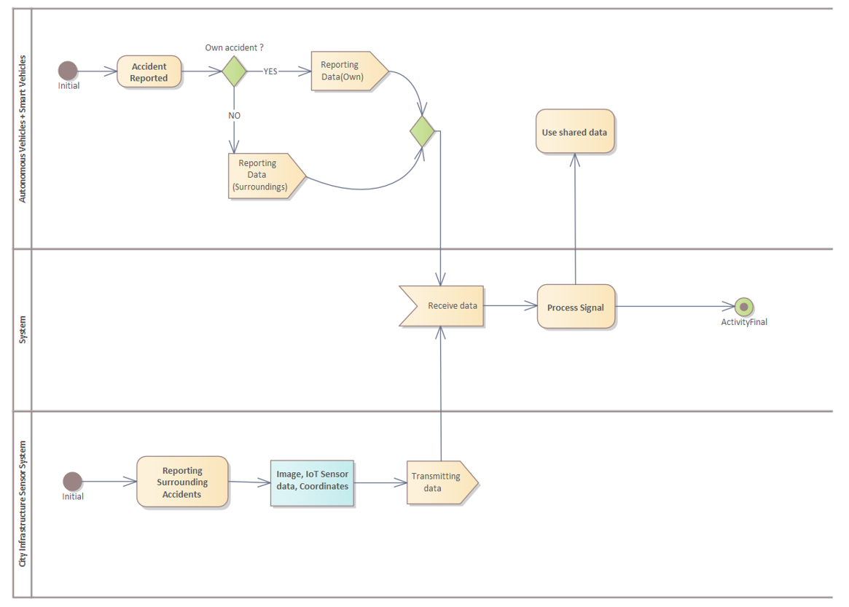
Figure: Accident Reporting System (Activity Diagram)

Slide 11
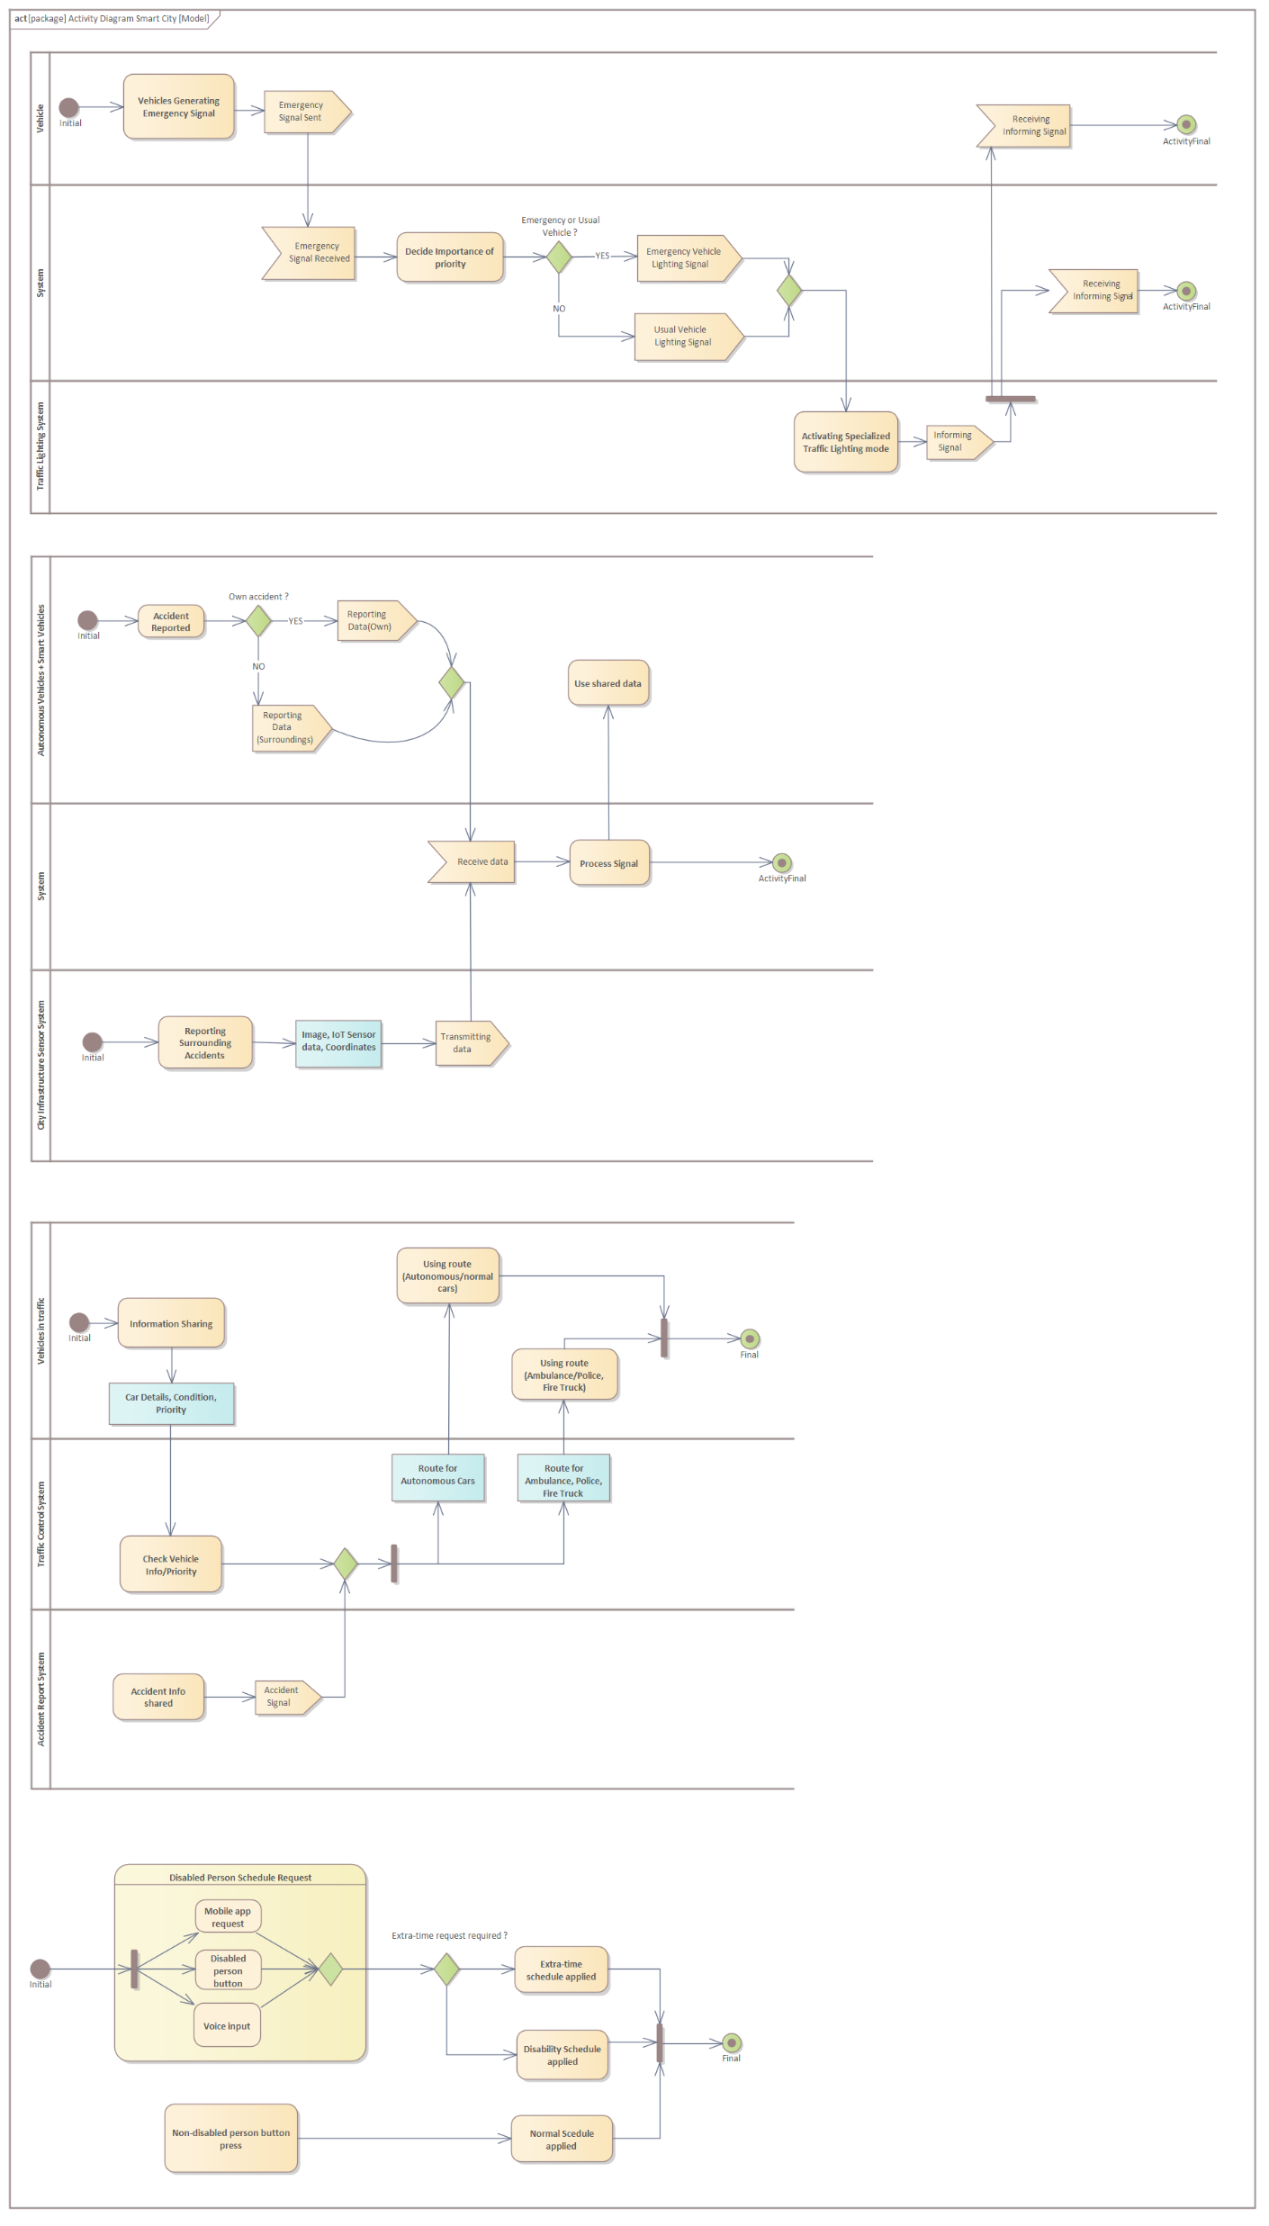
Figure: Vehicle Routing System (Activity Diagram)

Slide 12
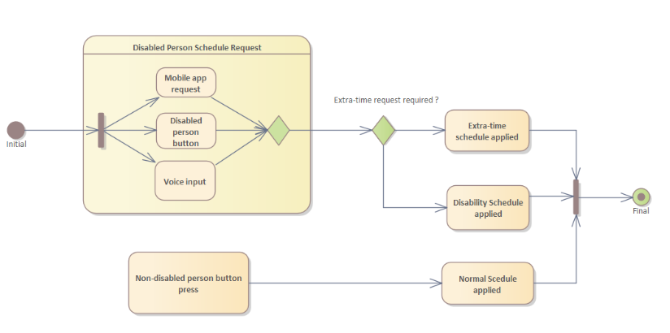
Figure: Smart Traffic Lighting for Pedestrians (Activity Diagram)

Slide 13
Design
(Context)Block Diagram

Slide 14
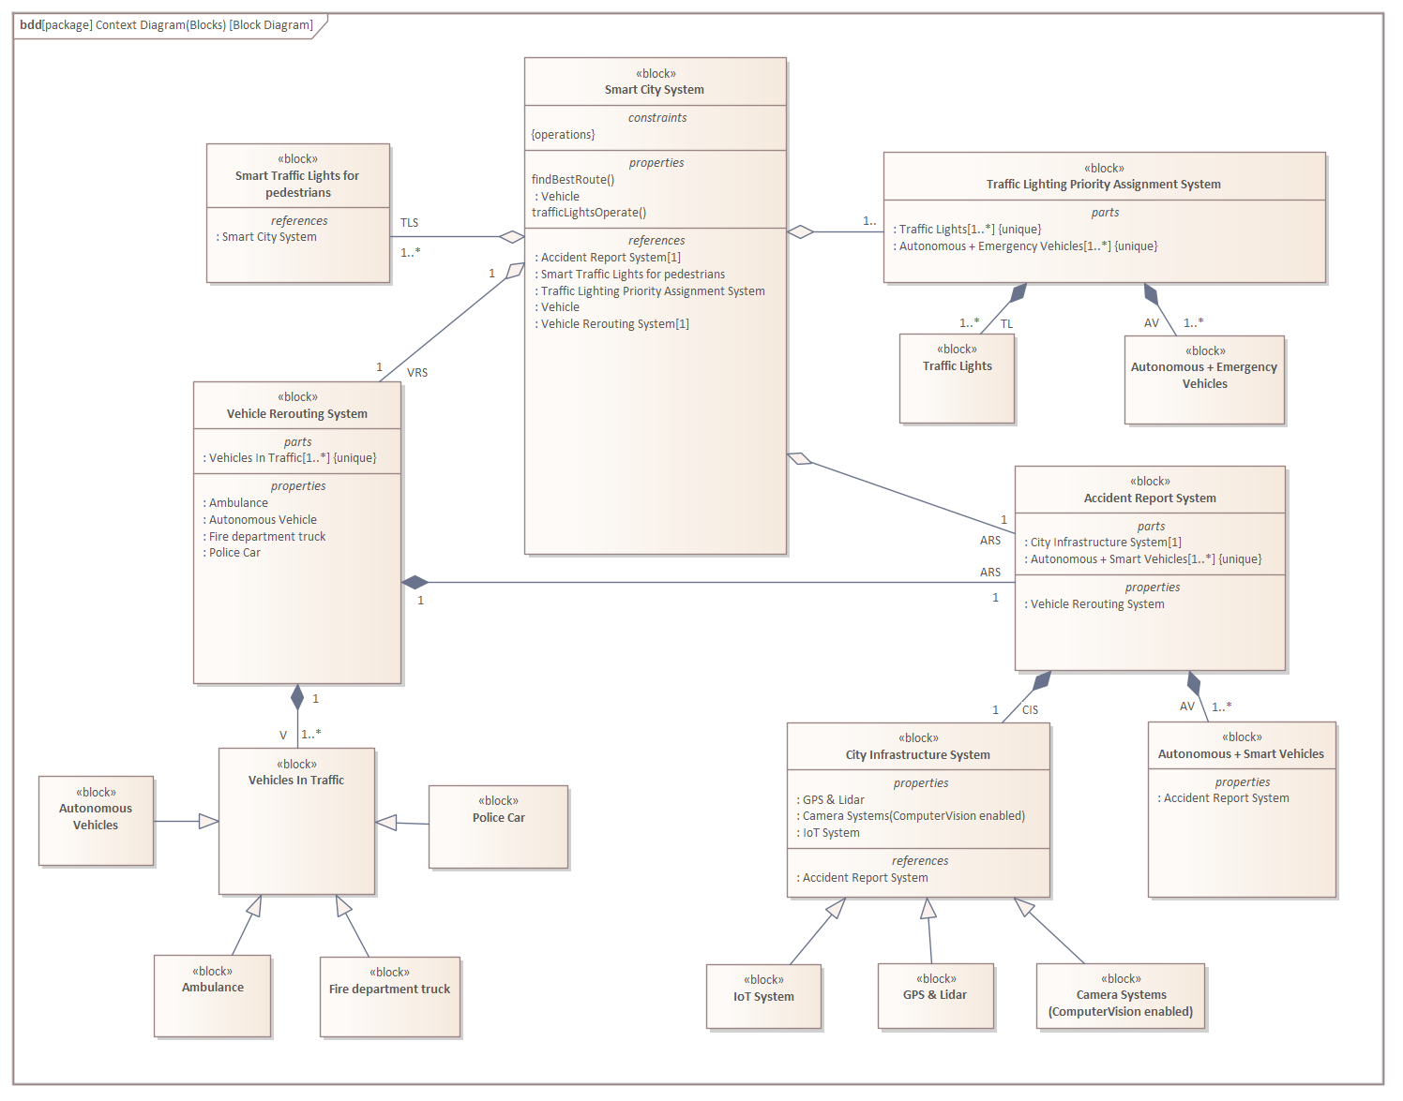
Smart City System
Smart Traffic Lights for Pedestrians
Vehicle Routing System
Traffic Lighting Priority Assignment
Traffic Lights
Autonomous + Emergency Vehicles
Accident Report System
City Infrastructure
Autonomous + Smart Vehicles
Figure: Smart City System Architecture (Context) Block Diagram

Slide 15
Internal Block Diagrams

Slide 16
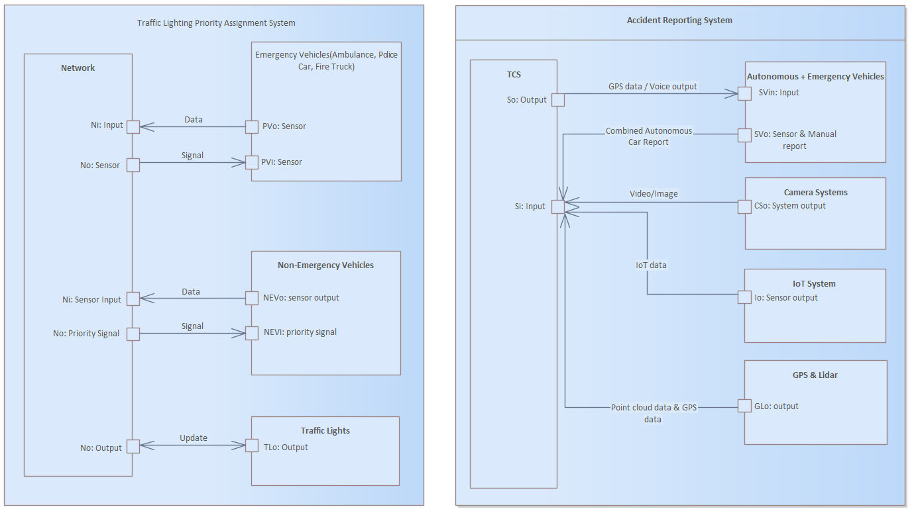
Figure: Traffic Lighting Priority Assignment System (Internal Block Diagram)
Figure: Accident Reporting System (Internal Block Diagram)

Slide 17
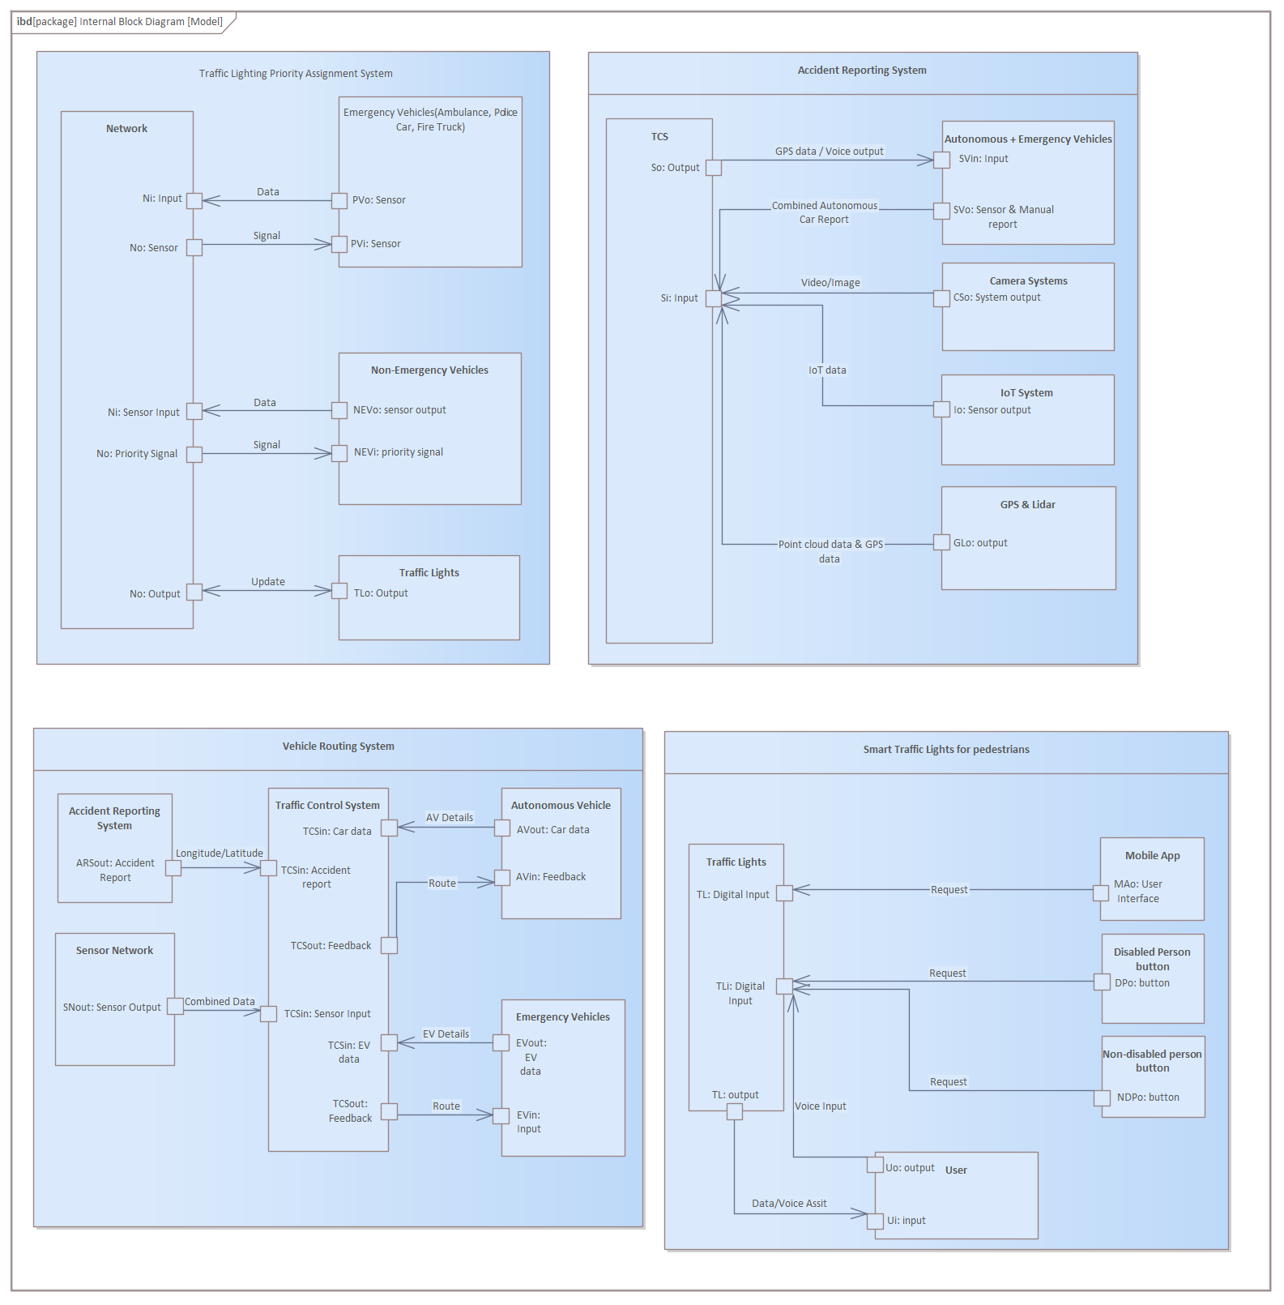
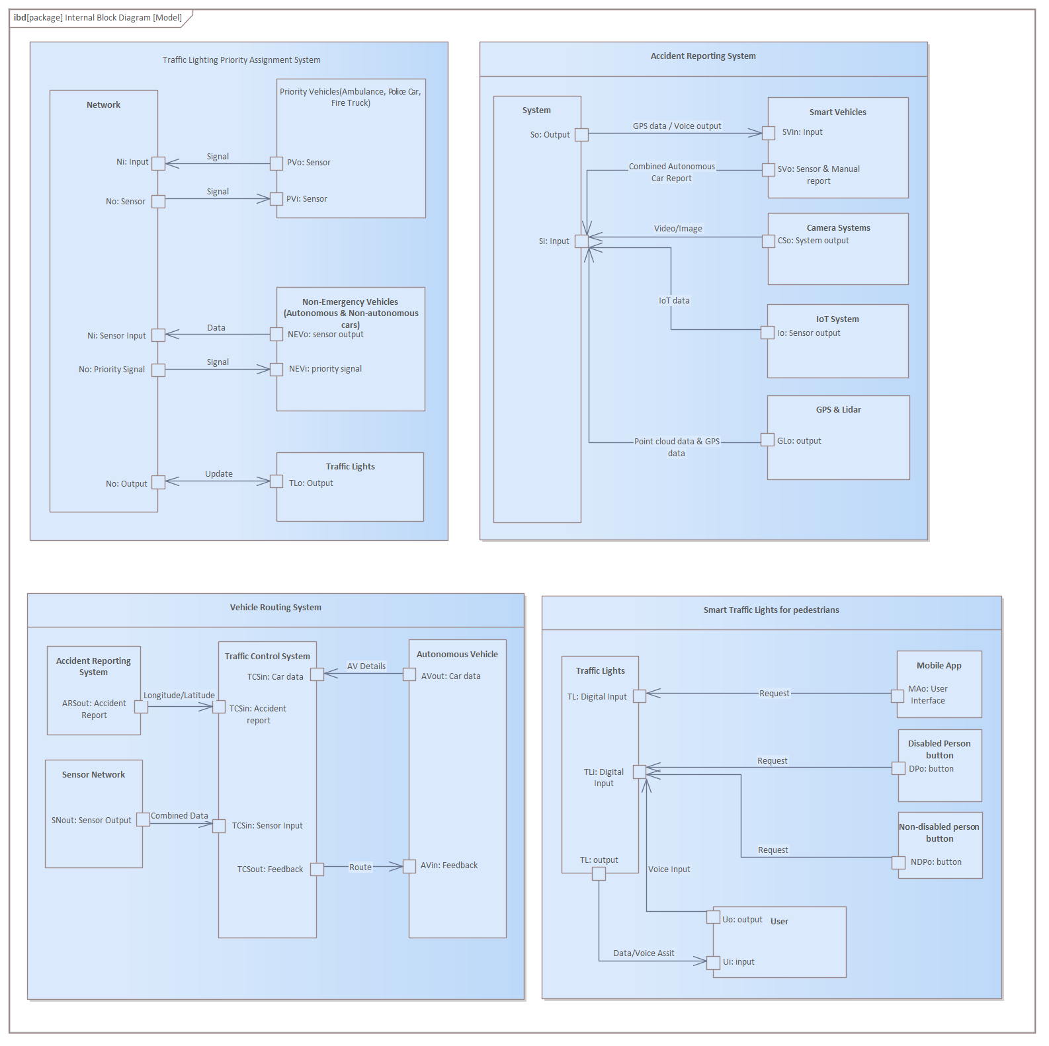
Figure: Vehicle Routing System (Internal Block Diagram)
Figure: Smart Traffic Lights for Pedestrians (Internal Block Diagram)

Slide 18
Figure: Internal Block Diagrams (Overview)

Slide 19
Constraint Block Parametrics Diagrams
Specification

Slide 20
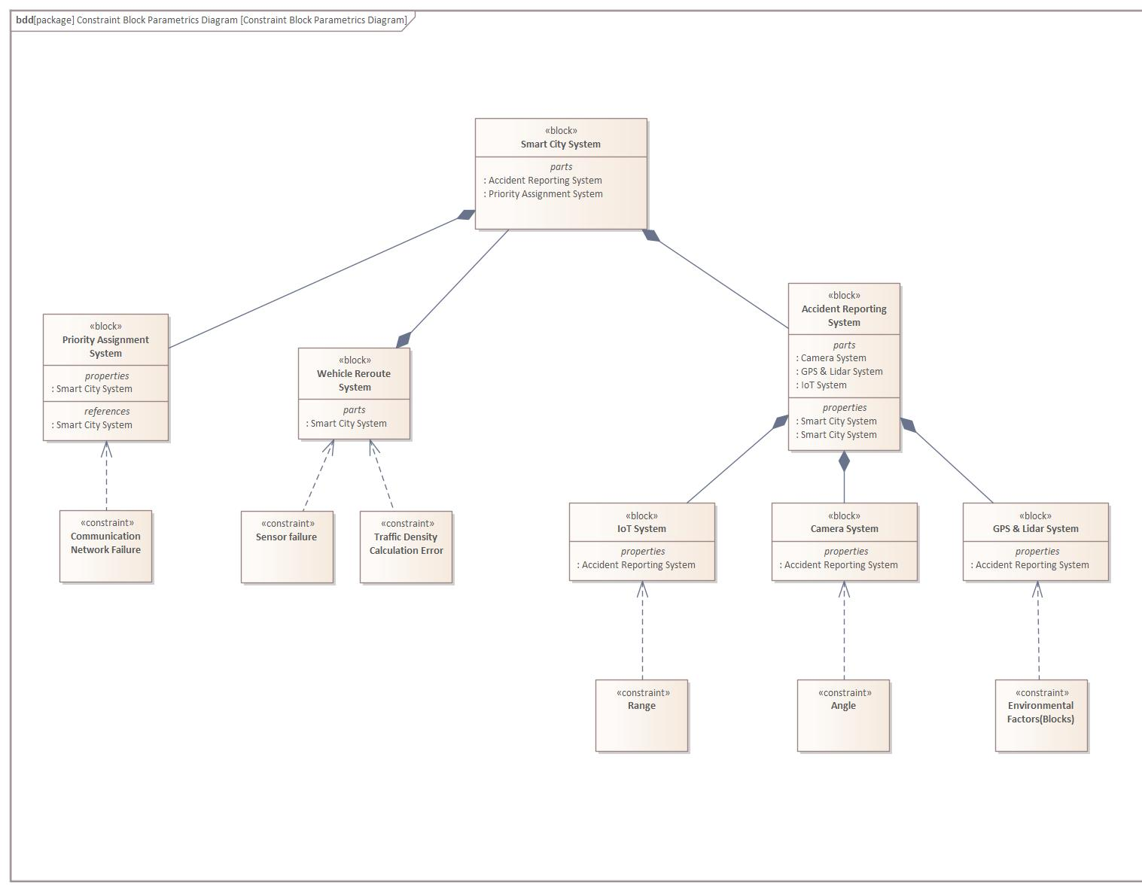
To interrelate use cases
Figure : Smart City System Constraint Block Diagram

Slide 21
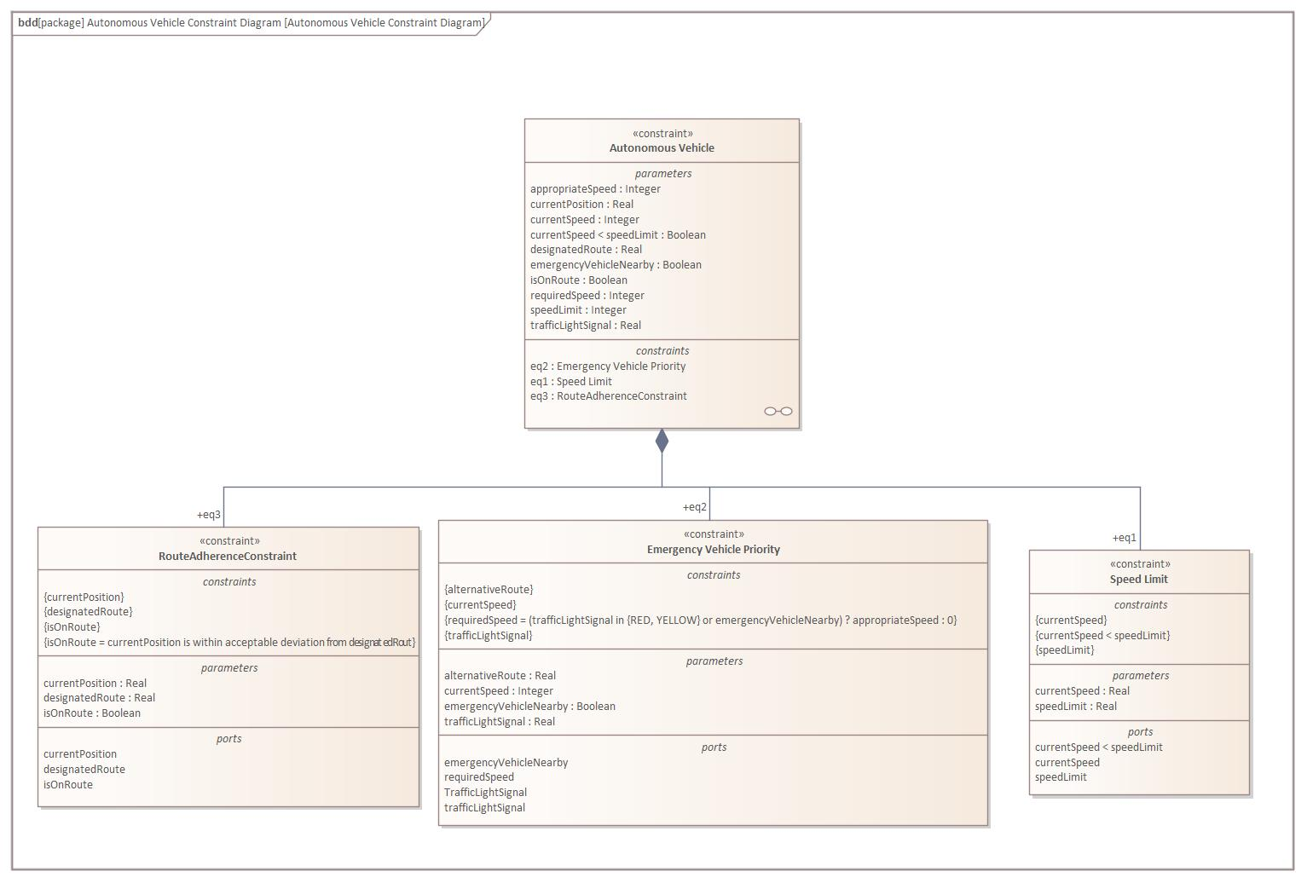
Time constraint for signals
Figure : Autonomous Emergency Vehicle Priority Constraint Block Diagram

Slide 22
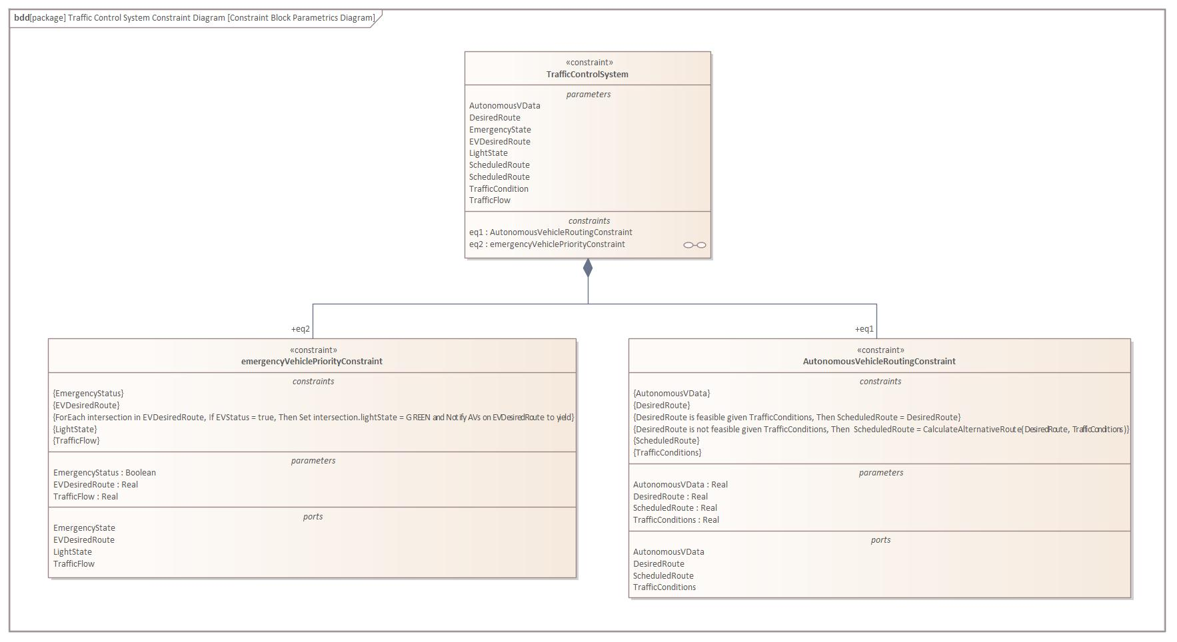
Real-time traffic condition constraint
Figure : Traffic Control System Emergency Rerouting Constraint Block Diagram

Slide 23
State Machine Diagrams

Slide 24
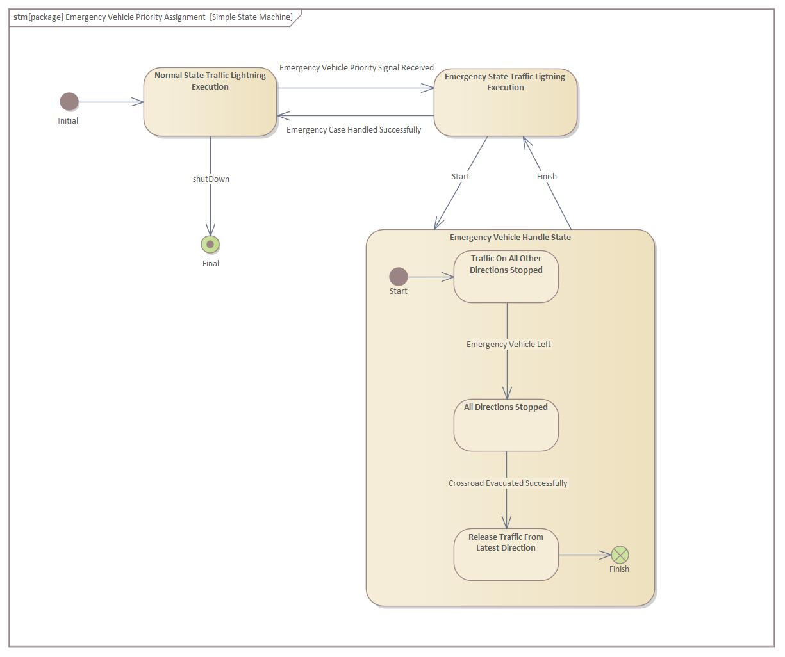
To visualize system behaviour
Figure : Emergency Vehicle Priority Assignment SMD

Slide 25
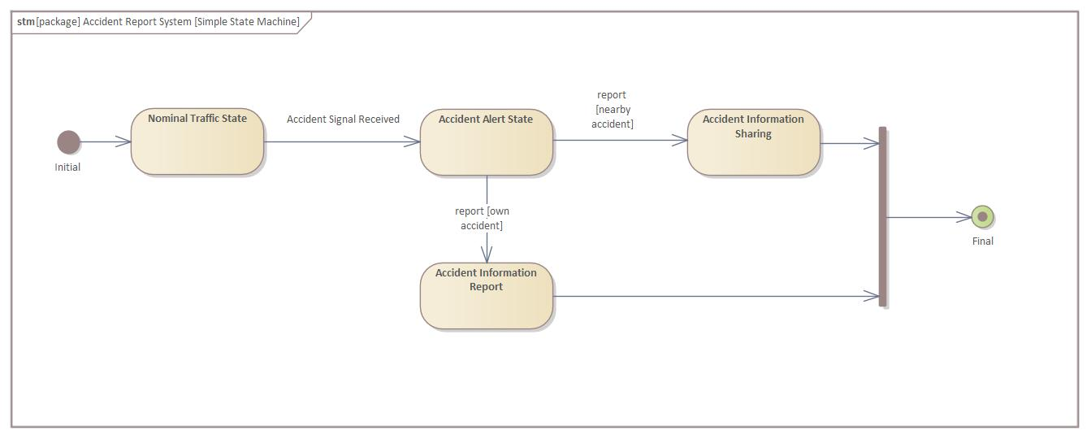
Adjusted design regarding use case scenario
Figure : Automated Accident Report SMD

Slide 26
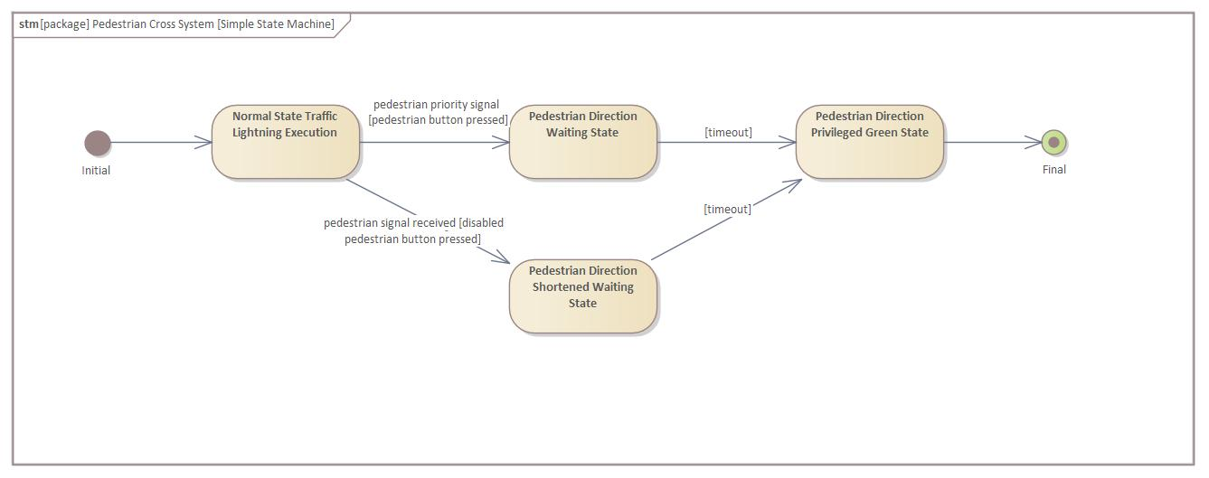
Signals and timeouts for state transition
Figure : Pedestrian Cross SMD

Slide 27
Fault Trees

Slide 28
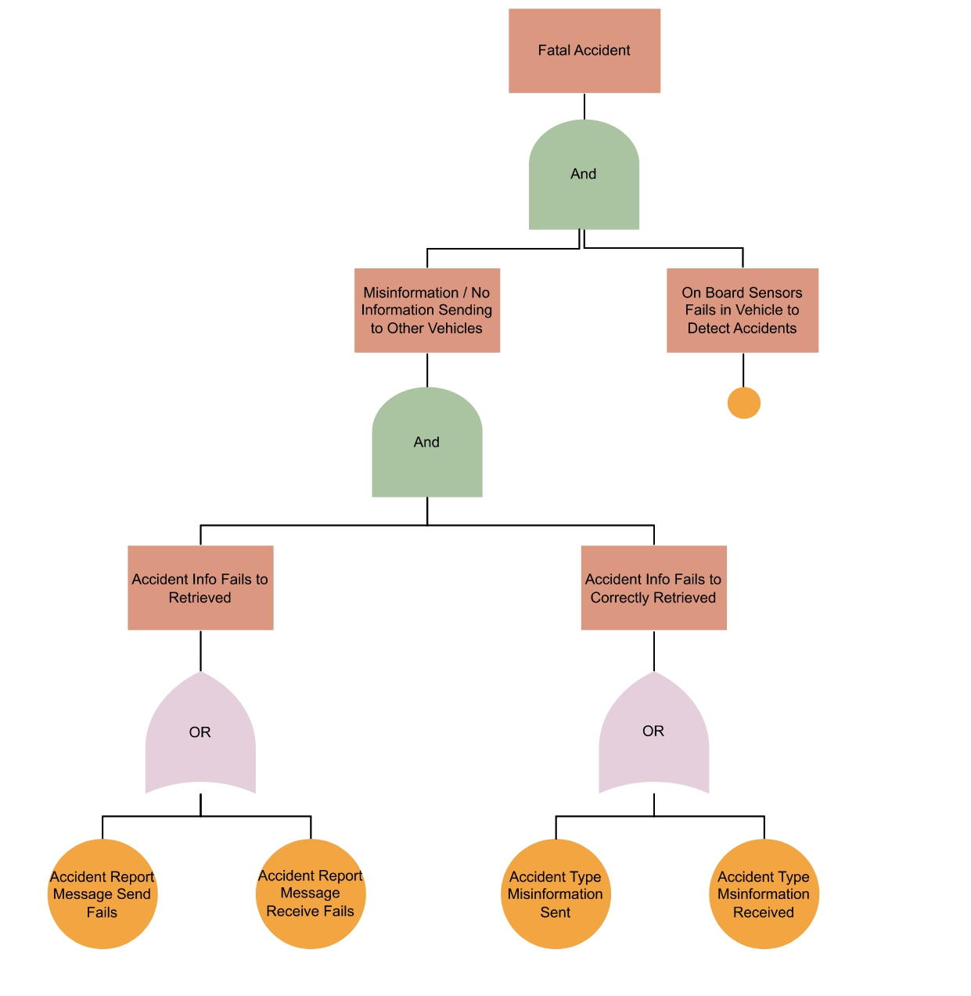
To foresee possible risks
Figure : Automated Accident Report Fault Tree Diagram

Slide 29
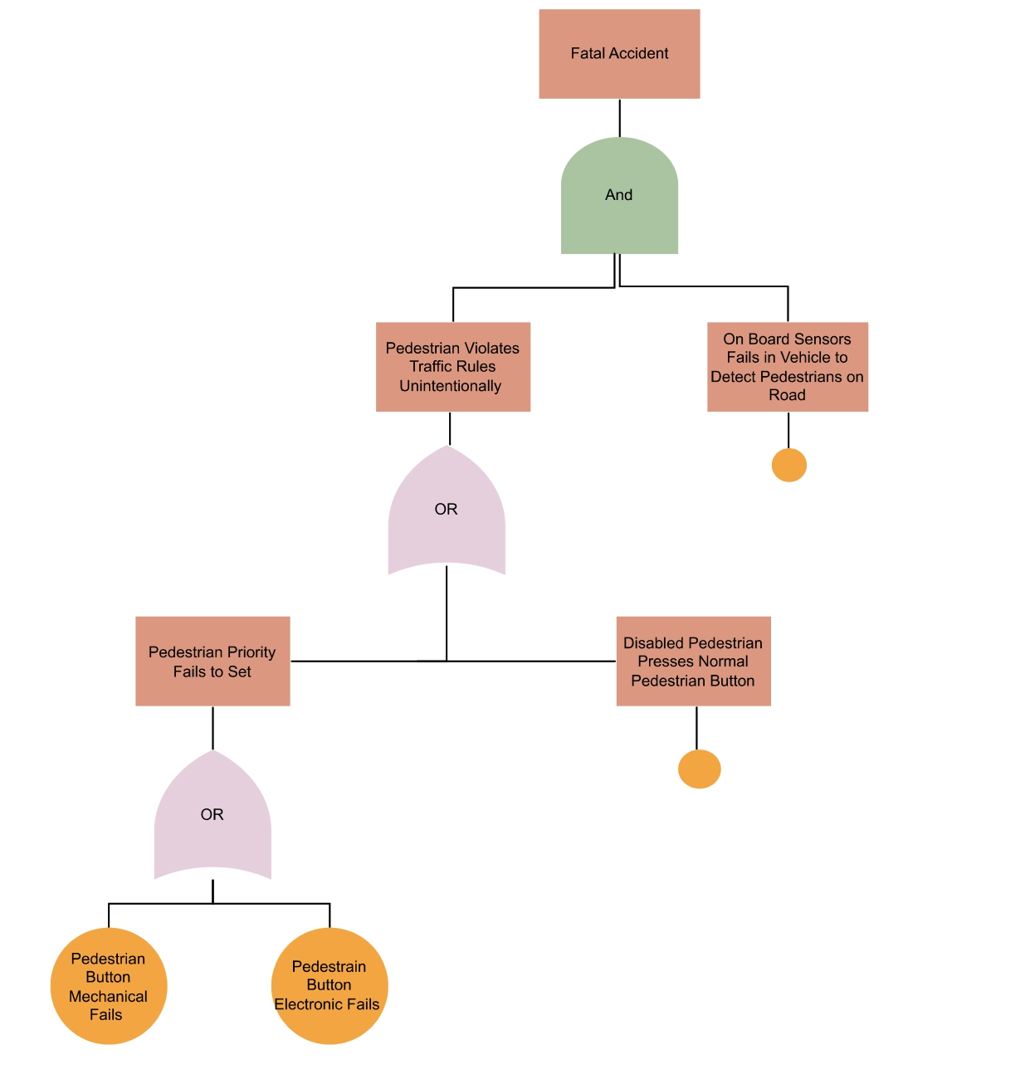
Combination of hazards leads to fatal accident
Figure : Pedestrian Cross Fault Tree Diagram

Slide 30
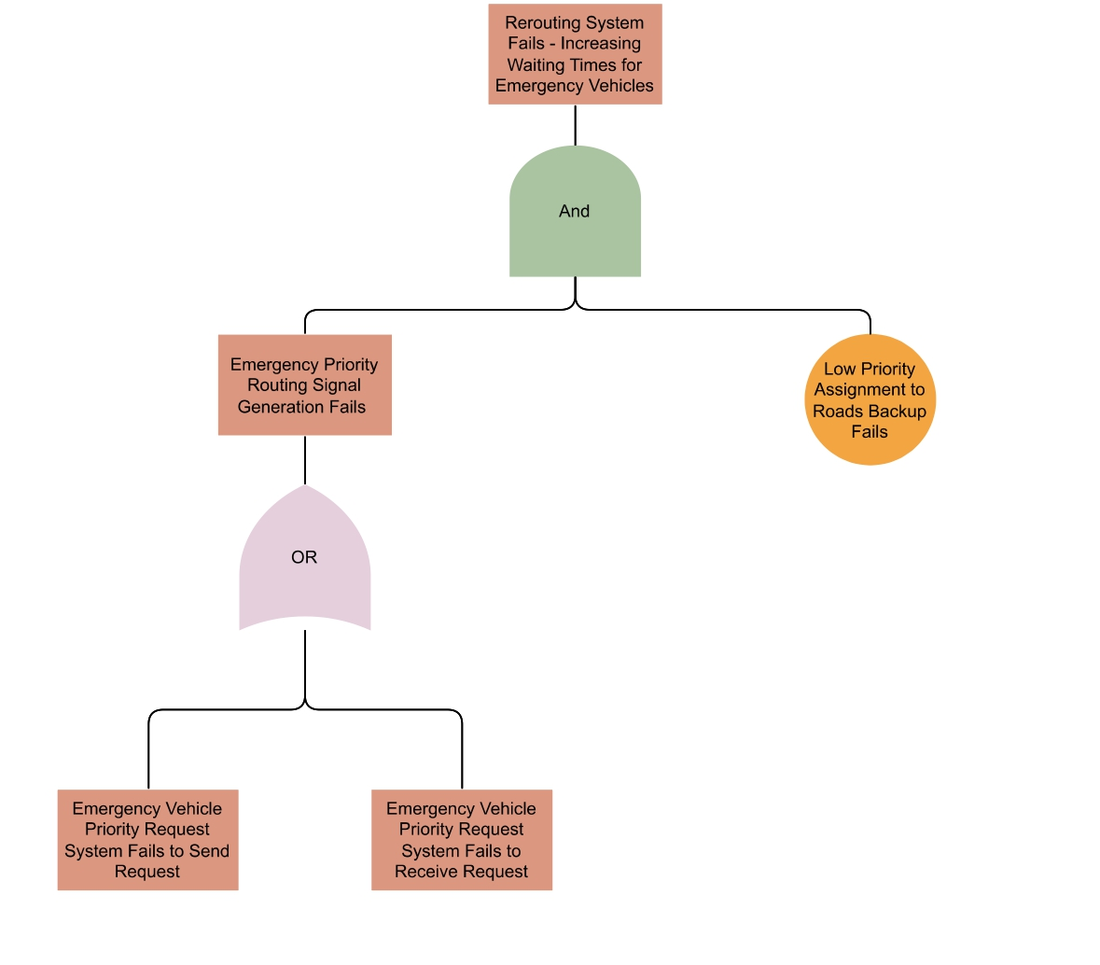
Hazards leading unoptimized behaviour
Figure : Emergency Vehicle Priority Fault Tree Diagram

Slide 31
Implementation
Connectivity & Realized Sequence
Example Sequence
Scheduling
Testing

Slide 32
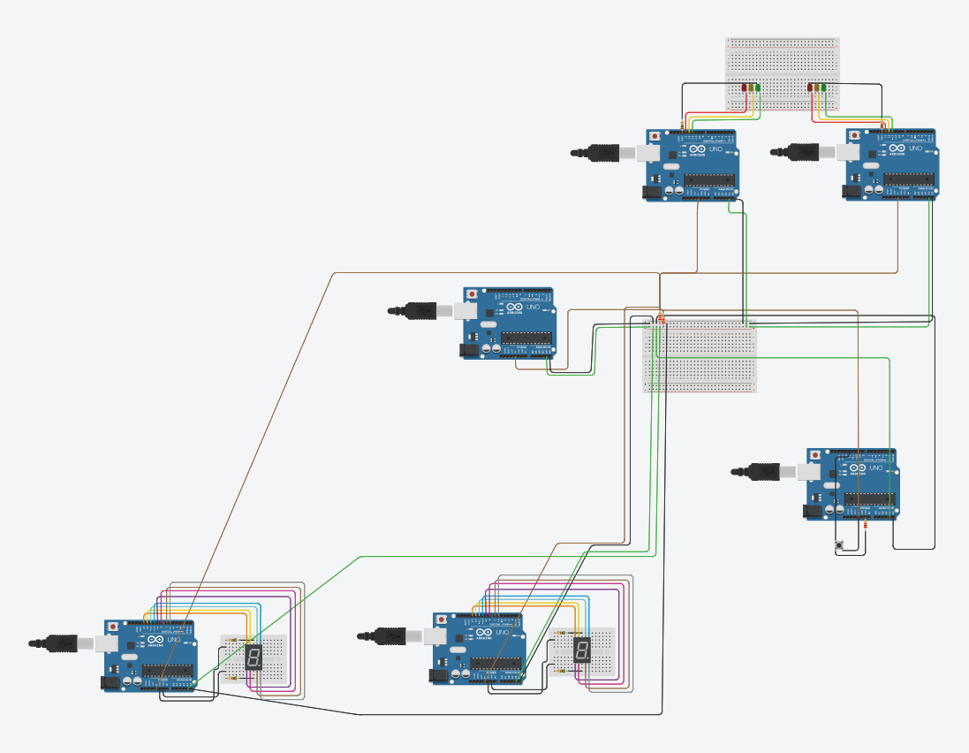
Connectivity& Realized Sequence
Traffic Light System
Traffic Control System
Autonomous Vehicles
Emergency Vehicle and Button

Slide 33
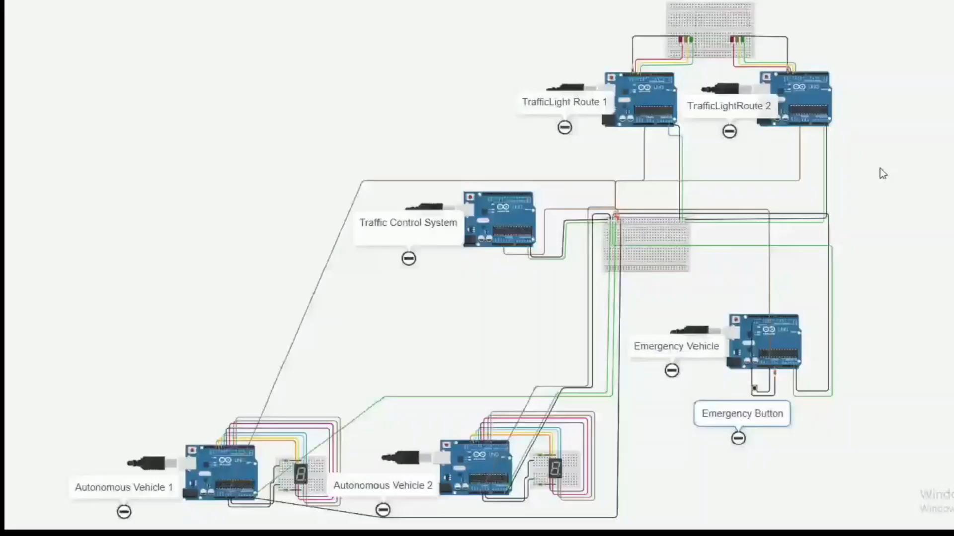

Slide 34
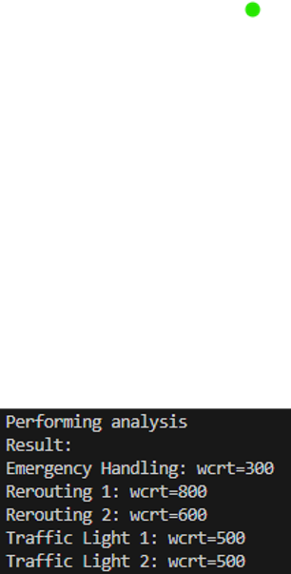
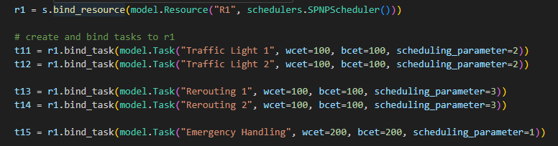
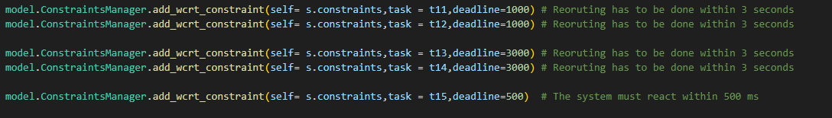
PyCPA Test with Static Priority Non-Preemptive Scheduler

Slide 35
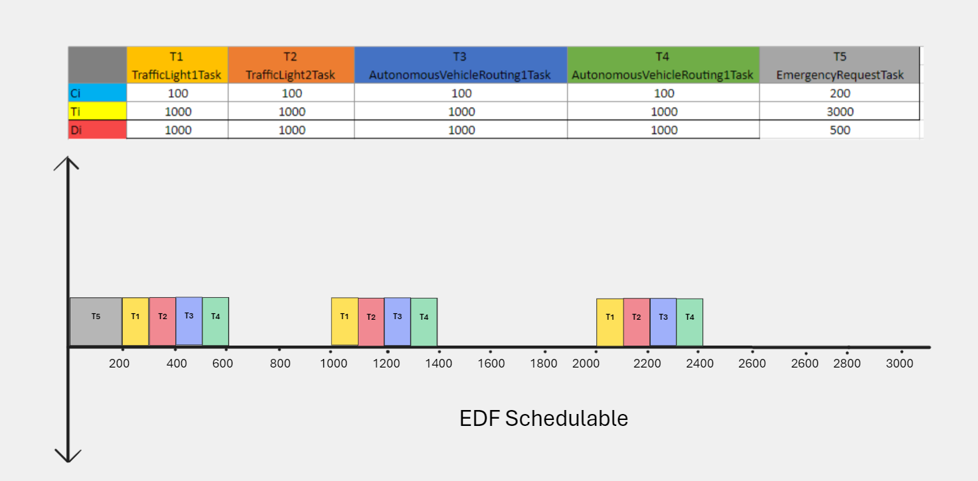

Slide 36
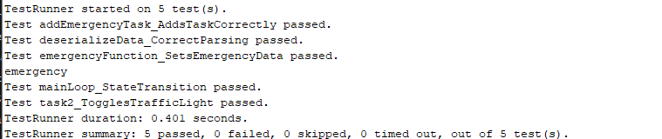
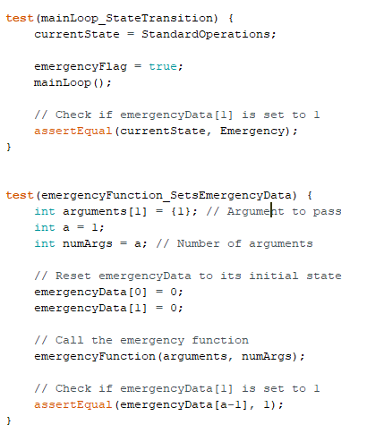
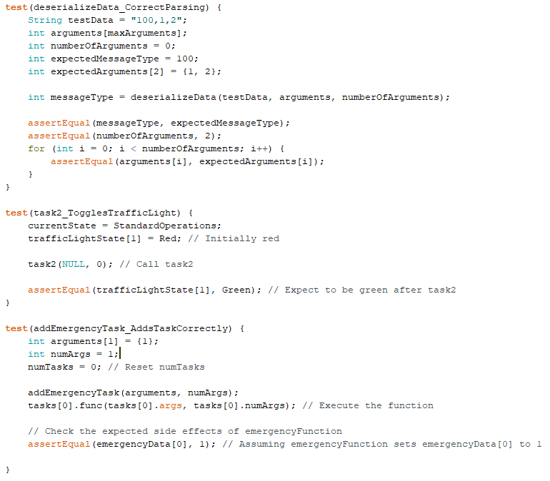

Slide 37
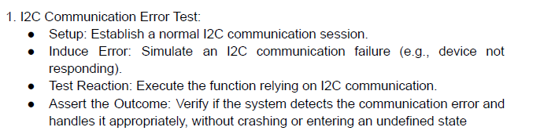
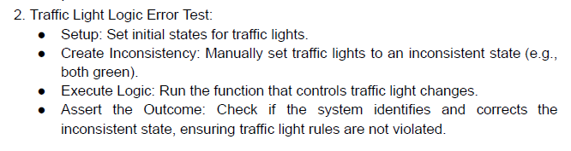
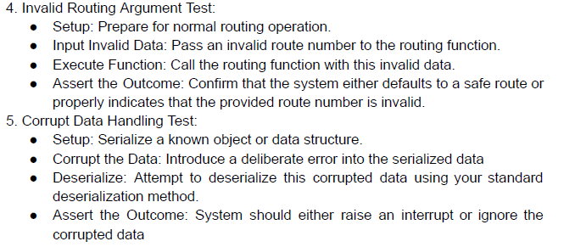
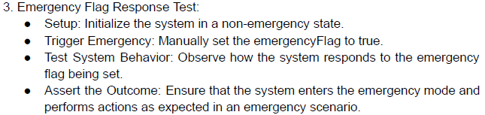
Defect Tests

